Slide 1
Classification
Decision Tree Induction
Best Split
Measures of Node Impurity

Slide 2
Algorithm for Decision Tree Induction
Basic algorithm (a greedy algorithm)
Tree is constructed in a top-down recursive divide-and-conquer manner
At start, all the training examples are at the root
Attributes are categorical (if continuous-valued, they are discretized in advance)
Examples are partitioned recursively based on selected attributes
Test attributes are selected on the basis of a heuristic or statistical measure (e.g., information gain)
Conditions for stopping partitioning
All samples for a given node belong to the same class
There are no remaining attributes for further partitioning – majority voting is employed for classifying the leaf
There are no samples left

Slide 3
Decision Tree Induction: Training Dataset

Slide 4
Output: A Decision Tree for “buys_computer”
age?
<=30
overcast
>40
31..40
student?
yes
credit rating?
no
yes
excellent
fair
no
yes
no
yes

Slide 5
Decision Tree Classification
A decision tree is created in two phases:
Tree Building Phase
Repeatedly partition the training data until all the examples in each partition belong to one class or the partition is sufficiently small
Tree Pruning Phase
Remove dependency on statistical noise or variation that may be particular only to the training set

Slide 6
Tree Building Phase
General tree-growth algorithm (binary tree)
Partition(Data S)
If (all points in S are of the same class) then return;
for each attribute A do
evaluate splits on attribute A;
Use best split to partition S into S1 and S2;
Partition(S1);
Partition(S2);

Slide 7
Tree Building Phase (cont.)
The form of the split depends on the type of the attribute
Splits for numeric attributes are of the form A ≤ v, where v is a real number
Splits for categorical attributes are of the form A ∈ S’, where S’ is a subset of all possible values of A

Slide 8
Tree Induction
Greedy strategy.
Split the records based on an attribute test that optimizes certain criterion.
Issues
Determine how to split the records
How to specify the attribute test condition?
How to determine the best split?
Determine when to stop splitting

Slide 9
How to Specify Test Condition?
Depends on attribute types
Nominal
Ordinal
Continuous
Depends on number of ways to split
2-way split
Multi-way split

Slide 10
Splitting Based on Nominal Atts.
Multi-way split: Use as many partitions as distinct values.
Binary split: Divides values into two subsets. Need to find optimal partitioning.
CarType
Family
Luxury
Sports
CarType
CarType
OR
{Sports, Luxury}
{Family, Luxury}
{Family}
{Sports}

Slide 11
Splitting Based on Ordinal Attributes
Multi-way split: Use as many partitions as distinct values.
Binary split: Divides values into two subsets. Need to find optimal partitioning.
What about this split?
Size
Small
Large
Medium
Size
Size
{Small, Medium}
OR
{Large}
{Medium, Large}
{Small}
Size
{Small, Large}
{Medium}

Slide 12
Splitting Based on Continuous Atts.
Different ways of handling
Discretization to form an ordinal categorical attribute
discretize once at the beginning
ranges can be found by equal interval bucketing, equal frequency bucketing (percentiles), or clustering.
Binary Decision: (A < v) or (A ≥ v)
consider all possible splits and finds the best cut
can be more compute intensive

Slide 13
Splitting Based on Continuous Atts.

Slide 14
Tree Induction
Greedy strategy.
Split the records based on an attribute test that optimizes certain criterion.
Issues
Determine how to split the records
How to specify the attribute test condition?
How to determine the best split?
Determine when to stop splitting

Slide 15
How to determine the Best Split
Before Splitting: 10 records of class 0, 10 records of class 1
Which test condition is the best?

Slide 16
How to determine the Best Split
Greedy approach:
Nodes with homogeneous class distribution are preferred
Need a measure of node impurity:
Non-homogeneous,
High degree of impurity
Uniform
Homogeneous,
Low degree of impurity
Skewed

Slide 17
Measures of Node Impurity
Measures of Node Impurity
Gini Index
Entropy
Misclassification error

Slide 18
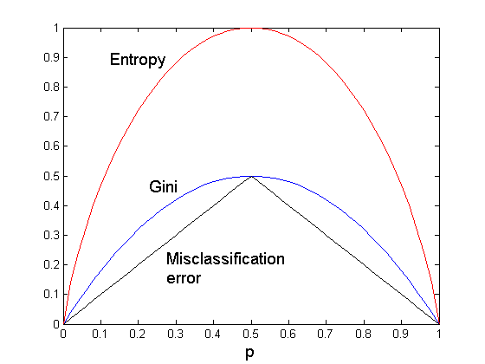
Comparison among Splitting Criteria
For a 2-class problem:

Slide 19
How to Find the Best Split
Before Splitting:
M0
A?
B?
Yes
No
Yes
No
Node N1
Node N2
Node N3
Node N4
M1
M2
M3
M4
M12
M34
Gain = M0 – M12 vs M0 – M34

Slide 20
Splitting Criteria based on INFO
Entropy at a given node t:
(NOTE: p( j | t) is the relative frequency of class j at node t).
Measures homogeneity of a node.
Maximum (log n_{c}) when records are equally distributed among all classes implying least information
Minimum (0.0) when all records belong to one class, implying most information

Slide 21
Examples for computing Entropy
P(C1) = 0/6 = 0 P(C2) = 6/6 = 1
Entropy = – 0 log 0 – 1 log 1 = – 0 – 0 = 0
P(C1) = 1/6 P(C2) = 5/6
Entropy = – (1/6) log₂ (1/6) – (5/6) log₂ (1/6) = 0.65
P(C1) = 2/6 P(C2) = 4/6
Entropy = – (2/6) log₂ (2/6) – (4/6) log₂ (4/6) = 0.92

Slide 22
Measure of Impurity: GINI
Gini Index for a given node t :
(NOTE: p( j | t) is the relative frequency of class j at node t).
Maximum (1 - 1/n_{c}) when records are equally distributed among all classes, implying least interesting information
Minimum (0.0) when all records belong to one class, implying most interesting information

Slide 23
Examples for computing GINI
P(C1) = 0/6 = 0 P(C2) = 6/6 = 1
Gini = 1 – P(C1)² – P(C2)² = 1 – 0 – 1 = 0
P(C1) = 1/6 P(C2) = 5/6
Gini = 1 – (1/6)² – (5/6)² = 0.278
P(C1) = 2/6 P(C2) = 4/6
Gini = 1 – (2/6)² – (4/6)² = 0.444

Slide 24
Splitting Criteria based on Classification Error
Classification error at a node t :
Measures misclassification error made by a node.
Maximum (1 - 1/n_{c}) when records are equally distributed among all classes, implying least interesting information
Minimum (0.0) when all records belong to one class, implying most interesting information

Slide 25
Examples for Computing Error
P(C1) = 0/6 = 0 P(C2) = 6/6 = 1
Error = 1 – max (0, 1) = 1 – 1 = 0
P(C1) = 1/6 P(C2) = 5/6
Error = 1 – max (1/6, 5/6) = 1 – 5/6 = 1/6
P(C1) = 2/6 P(C2) = 4/6
Error = 1 – max (2/6, 4/6) = 1 – 4/6 = 1/3

Slide 26
Gain
Gain of an attribute split: compare the impurity of the parent node with the average impurity of the child nodes
Maximizing the gain ⇔ Minimizing the weighted average impurity measure of children nodes
If I() = Entropy(), then Δ_{info} is called information gain

Slide 27
Splitting Based on GINI
Used in CART, SLIQ, SPRINT.
When a node p is split into k partitions (children), the quality of split is computed as,
where, n_{i} = number of records at child i,
n = number of records at node p.
Weighted Average of Gini Index

Slide 28
Binary Attributes: Computing GINI Index
Splits into two partitions
Effect of Weighing partitions:
Larger and Purer Partitions are sought for.
B?
Yes
No
Node N1
Node N2
Gini(N1) = 1 – (5/7)² – (2/7)² = 0.41
Gini(N2) = 1 – (1/5)² – (4/5)² = 0.32
Gini(Children) = 7/12 * 0.41 + 5/12 * 0.32 = 0.37

Slide 29
Categorical Attributes: Computing Gini Index
For each distinct value, gather counts for each class in the dataset
Use the count matrix to make decisions
Multi-way split
Two-way split
(find best partition of values)

Slide 30
Continuous Attributes: Computing Gini Index
Use Binary Decisions based on one value
Several Choices for the splitting value
Number of possible splitting values = Number of distinct values
Each splitting value has a count matrix associated with it
Class counts in each of the partitions, A < v and A ≥ v
Simple method to choose best v
For each v, scan the database to gather count matrix and compute its Gini index
Computationally Inefficient! Repetition of work.

Slide 31
Continuous Attributes: Computing Gini Index..
For efficient computation: for each attribute,
Sort the attribute on values
Linearly scan these values, each time updating the count matrix and computing gini index
Choose the split position that has the least gini index
Sorted Values
Split Positions

Slide 32
Decision Tree Induction: Training Dataset

Slide 33
Attribute Selection: Information Gain
Class P: buys_computer = “yes”
Class N: buys_computer = “no”
means “age <=30” has 5 out of 14 samples, with 2 yes’es and 3 no’s. Hence
Similarly,

Slide 34
What is the entropy of this collection of training examples with respect to the positive class?
(b) What are the information gains of a1 and a2 relative to these training examples?

Slide 35
Splitting Based on INFO...
Information Gain:
Parent Node, p is split into k partitions;
n_{i} is number of records in partition i
Measures Reduction in Entropy achieved because of the split. Choose the split that achieves most reduction (maximizes GAIN)
Used in ID3 and C4.5
Disadvantage: Tends to prefer splits that result in large number of partitions, each being small but pure.

Slide 36
Splitting Based on INFO...
Gain Ratio:
Parent Node, p is split into k partitions
n_{i} is the number of records in partition i
Adjusts Information Gain by the entropy of the partitioning (SplitINFO). Higher entropy partitioning (large number of small partitions) is penalized!
Used in C4.5
Designed to overcome the disadvantage of Information Gain

Slide 37
Tree Induction
Greedy strategy.
Split the records based on an attribute test that optimizes certain criterion.
Issues
Determine how to split the records
How to specify the attribute test condition?
How to determine the best split?
Determine when to stop splitting

Slide 38
Stopping Criteria for Tree Induction
Stop expanding a node when all the records belong to the same class
Stop expanding a node when all the records have similar attribute values
Early termination (to be discussed later)

Slide 39
Decision Tree Based Classification
Advantages:
Inexpensive to construct. It does not require any domain knowledge.
Extremely fast at classifying unknown records
convertible to simple and easy to understand classification rules
Easy to interpret for small-sized trees
Accuracy is comparable to other classification techniques for many simple data sets

Slide 40
Example: C4.5
Simple depth-first construction.
Uses Information Gain
Sorts Continuous Attributes at each node.
Needs entire data to fit in memory.
Unsuitable for Large Datasets.
Needs out-of-core sorting.

Slide 41
Practical Issues of Classification
Underfitting and Overfitting
Missing Values
Costs of Classification

Slide 42
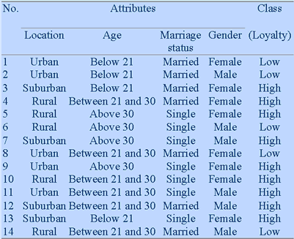
Another Example

Slide 43
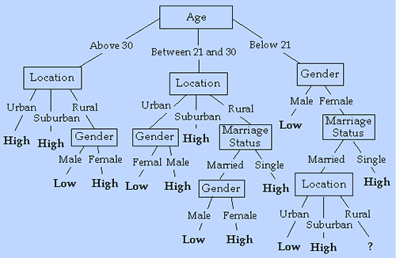
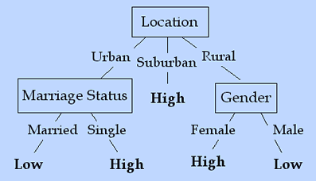
Another Example

Slide 44
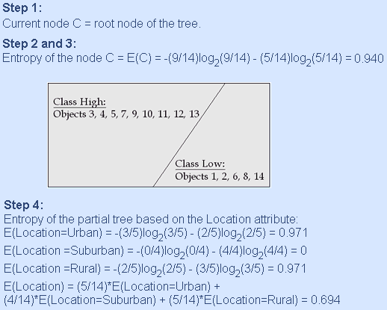
Decision Tree Generation Algorithm: ID3

Slide 45
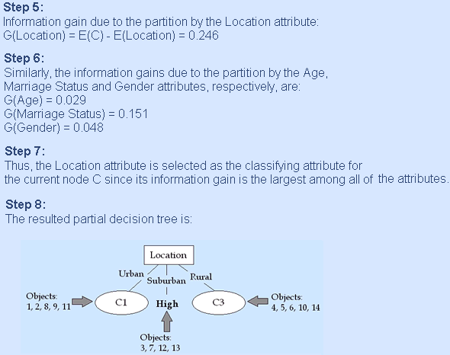
Decision Tree Generation Algorithm: ID3

Slide 46
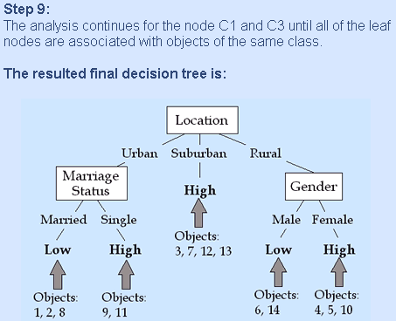
Decision Tree Generation Algorithm: ID3

